Slide 1
Analyzing New York City - Brooklyn Neighbourhood for setting up a Souvenir Shop

Slide 2
Business Problem & Approach
This study will be useful for the audience who wants to setup a Souvenir shop in the New York neighborhood but are not fully sure which is the right place.
Will try to find a place to setup such a shop, which is closer to parks, Coffee shops, Restaurants etc instead of buzzing places like Statue of Liberty.
Larger prospective/genuine buyers instead of just Window Shoppers.
Target Audience are all sers planning to setup a Souvenir Shop in New York City.

Slide 3
Data Source
https://ibm.box.com/shared/static/fbpwbovar7lf8p5sgddm06cgipa2rxpe.json
New York Data containing Borough', 'Neighborhood', 'Latitude', 'Longitude'

Slide 4
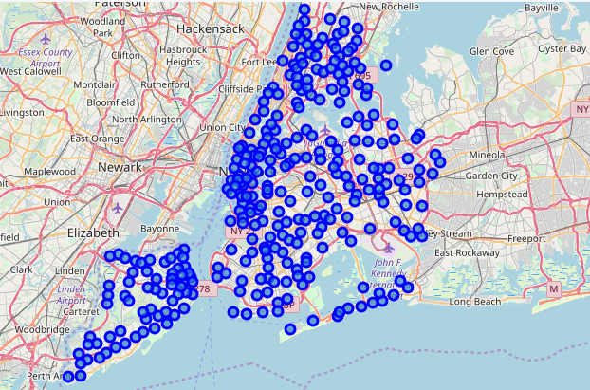
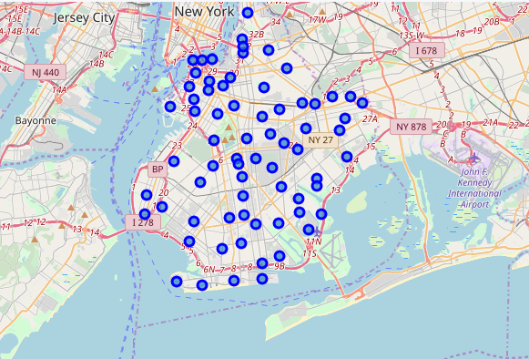
New York and Brooklyn Map Creation through Folium

Slide 5
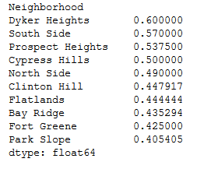
Result
Fetched needed data from DataFrame and found the sum of means for Restaurants, Parks, Bars, Gardens
List showing top Neighbourhood in Brooklyn having the highest number of Restaurants, Park, Gardens, Bar and Food Joints. Users can plan to setup Souvenir shop here and can expect maximum prospective buyers.

